Slide 1
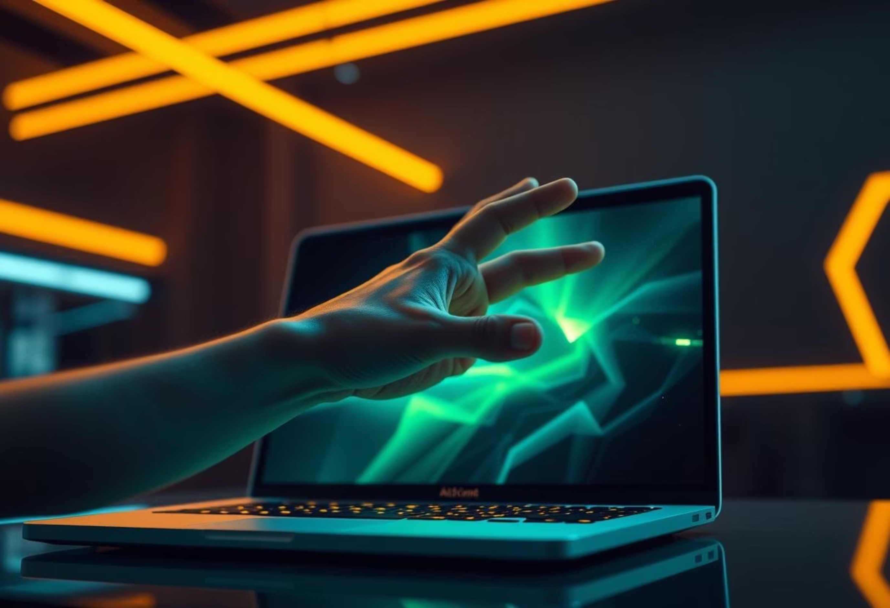
GestureFlow: Touch-Free Presentation Control
Revolutionise your presentations with intuitive hand gestures.

Slide 2
Introduction
The Power of Gesture-Controlled Presentations
In an era where remote work and hybrid models are prevalent, seamless and engaging presentations are more critical than ever. GestureFlow introduces a novel, touch-free way to interact with your slides, enhancing audience engagement and presenter fluidity. This system leverages advanced computer vision to transform simple hand movements into powerful presentation commands.

Slide 3
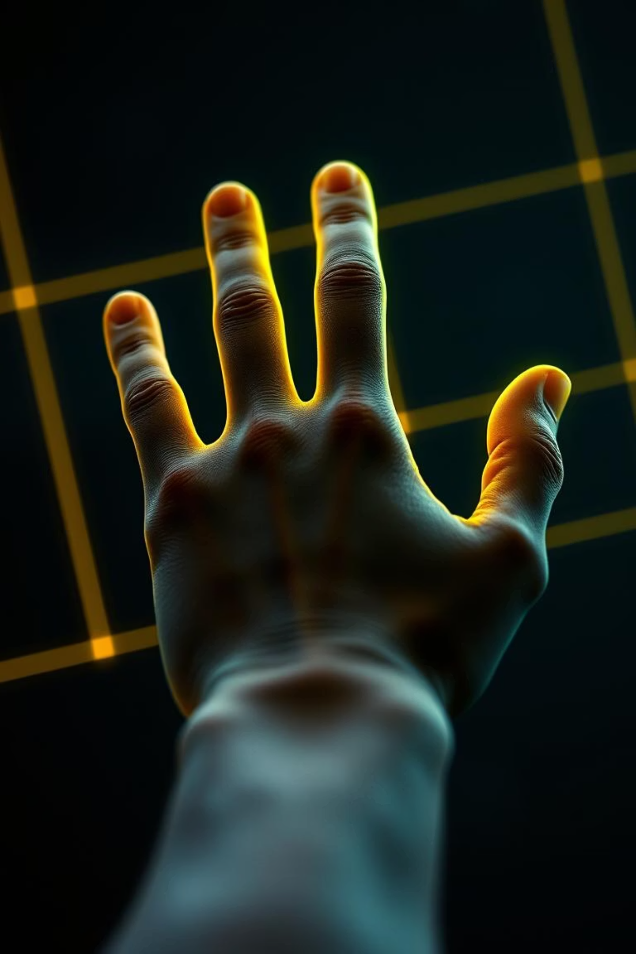
Core Functionality
Navigate with Simple Swipes
Swipe Palm
Effortlessly move to the next or previous slide with a simple left or right swipe of your open palm. This intuitive gesture provides a natural flow during your presentation, eliminating the need for clickers or keyboard inputs.

Slide 4
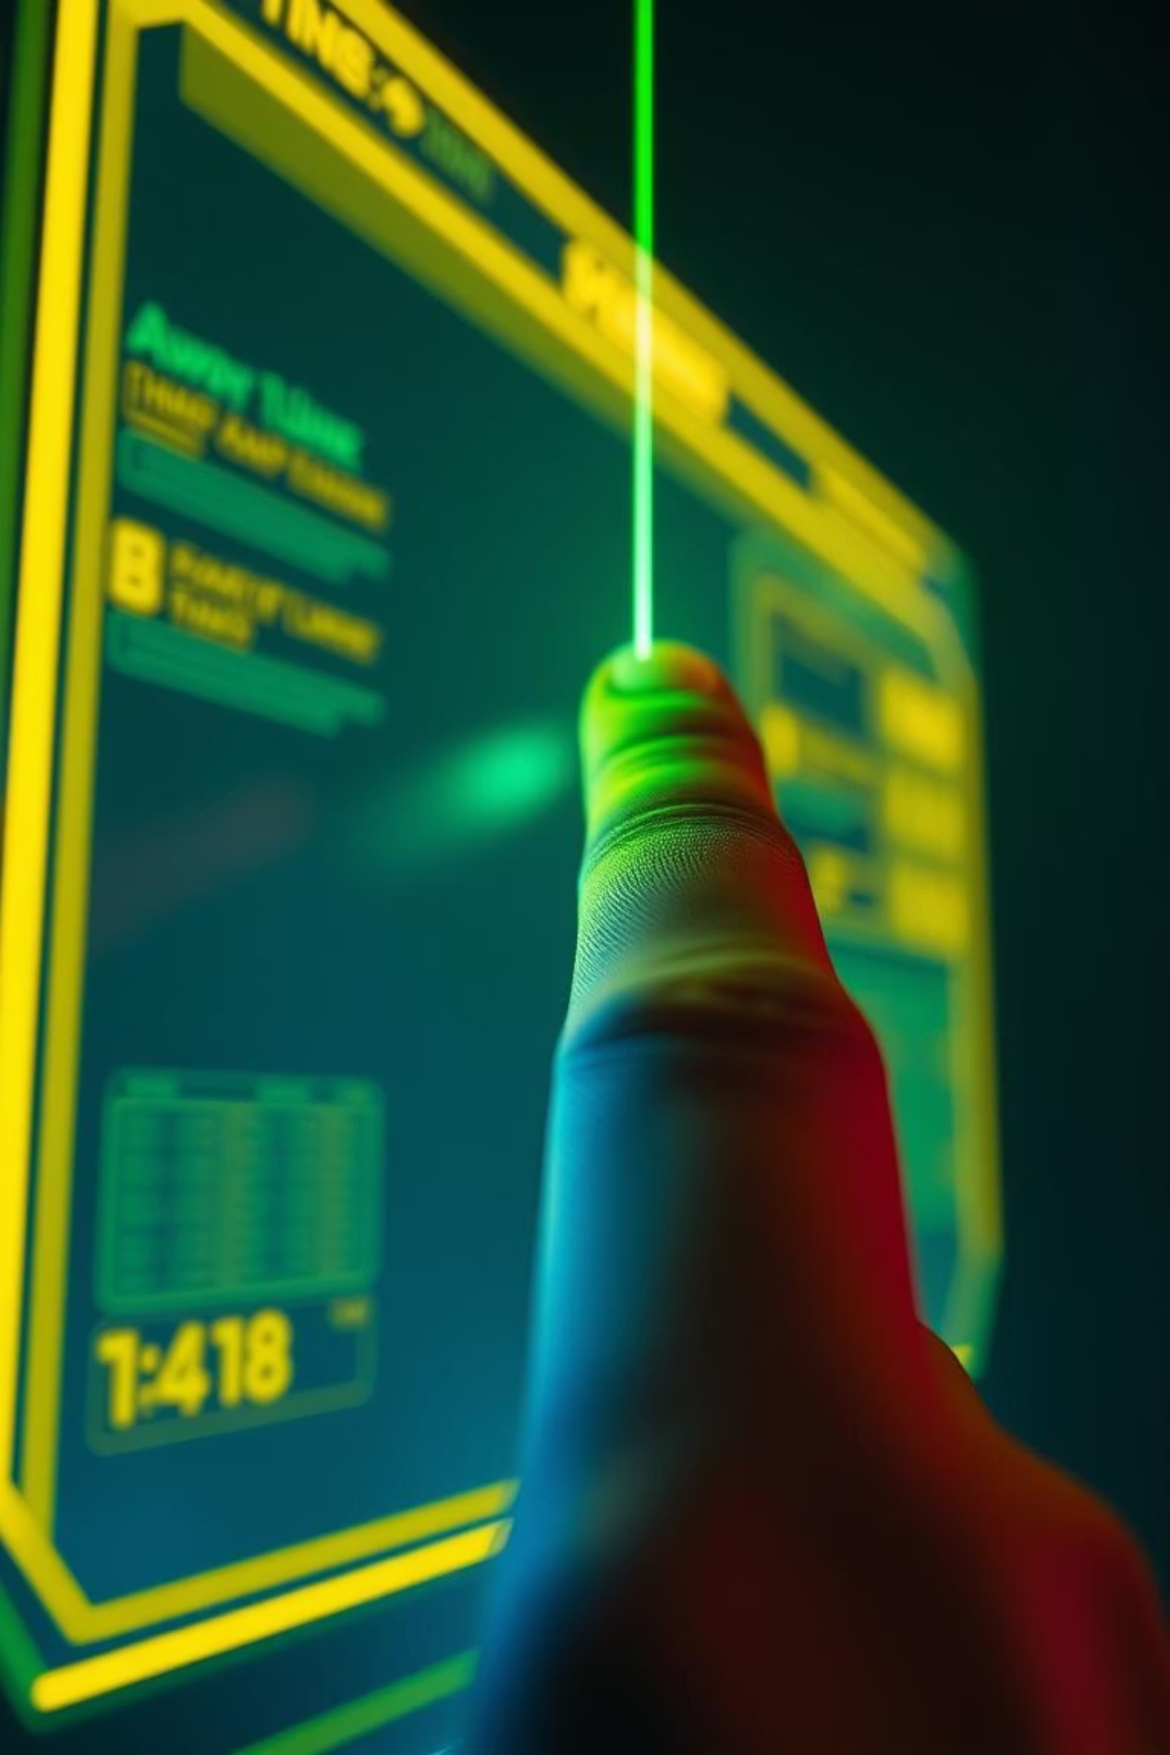

Precision Control
Pointer Accuracy
Index Finger
Transform your index finger into a dynamic on-screen pointer. Guide your audience's attention with fluid movements, highlighting key elements on your slides in real-time.

Slide 5
Enhanced Engagement
Dynamic Zoom Capabilities
Thumb + Index Pinch
Thumb + Index Spread
Instantly zoom in on specific content to reveal finer details. This gesture mimics natural interaction with touchscreens, making complex diagrams or small text easily readable for your audience.
Quickly zoom out to provide a broader overview or transition back to the full slide. Maintain visual continuity and control the focus of your presentation with precise, intuitive hand gestures.

Slide 6





Technology Under the Hood
Seamless Integration, Powerful Performance
GestureFlow is built on a robust foundation of cutting-edge libraries and frameworks, ensuring high accuracy and smooth operation.
Python
OpenCV
The core programming language, providing flexibility and extensive library support for rapid development.
Essential for real-time image processing and capturing webcam input, forming the visual backbone.
MediaPipe
PyAutoGUI
Powers accurate hand tracking and landmark detection, translating complex movements into usable data.
Simulates keyboard and mouse inputs, enabling seamless control over any presentation software.

Slide 7
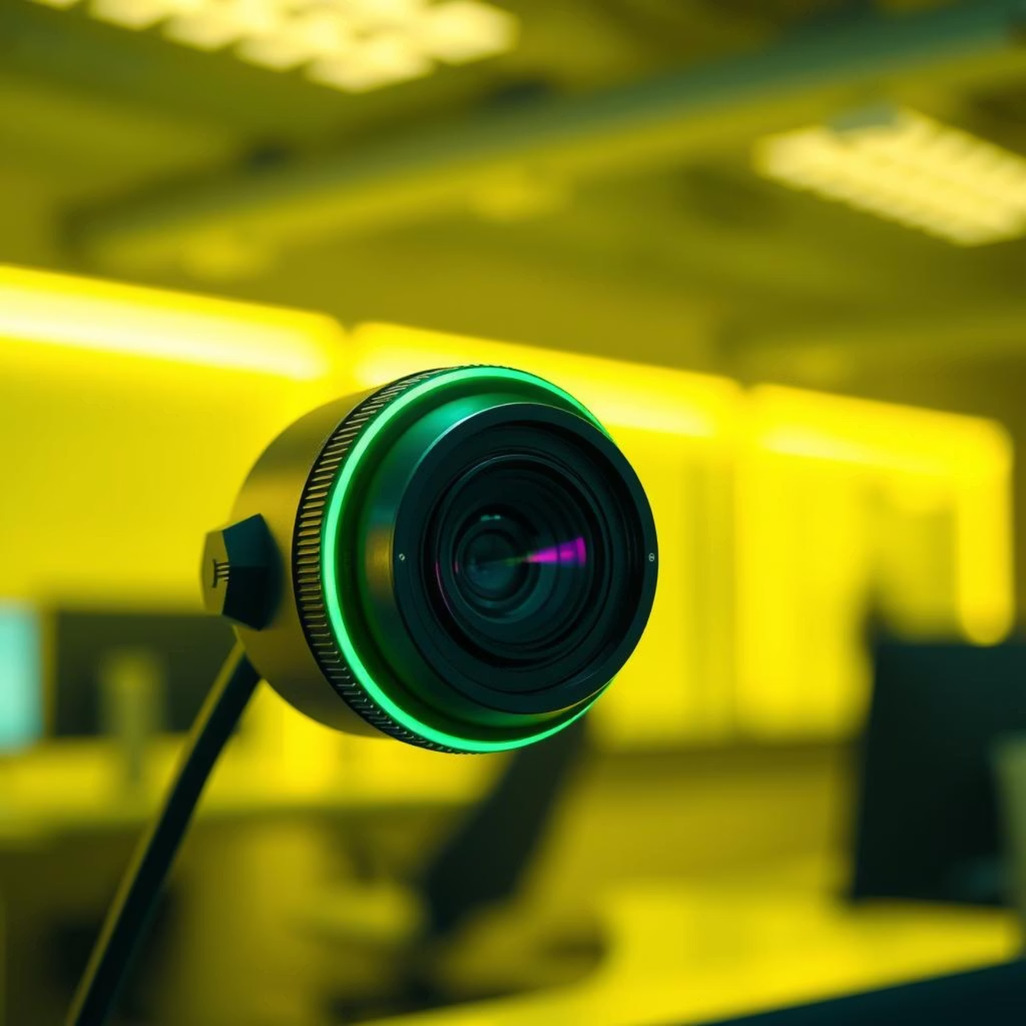
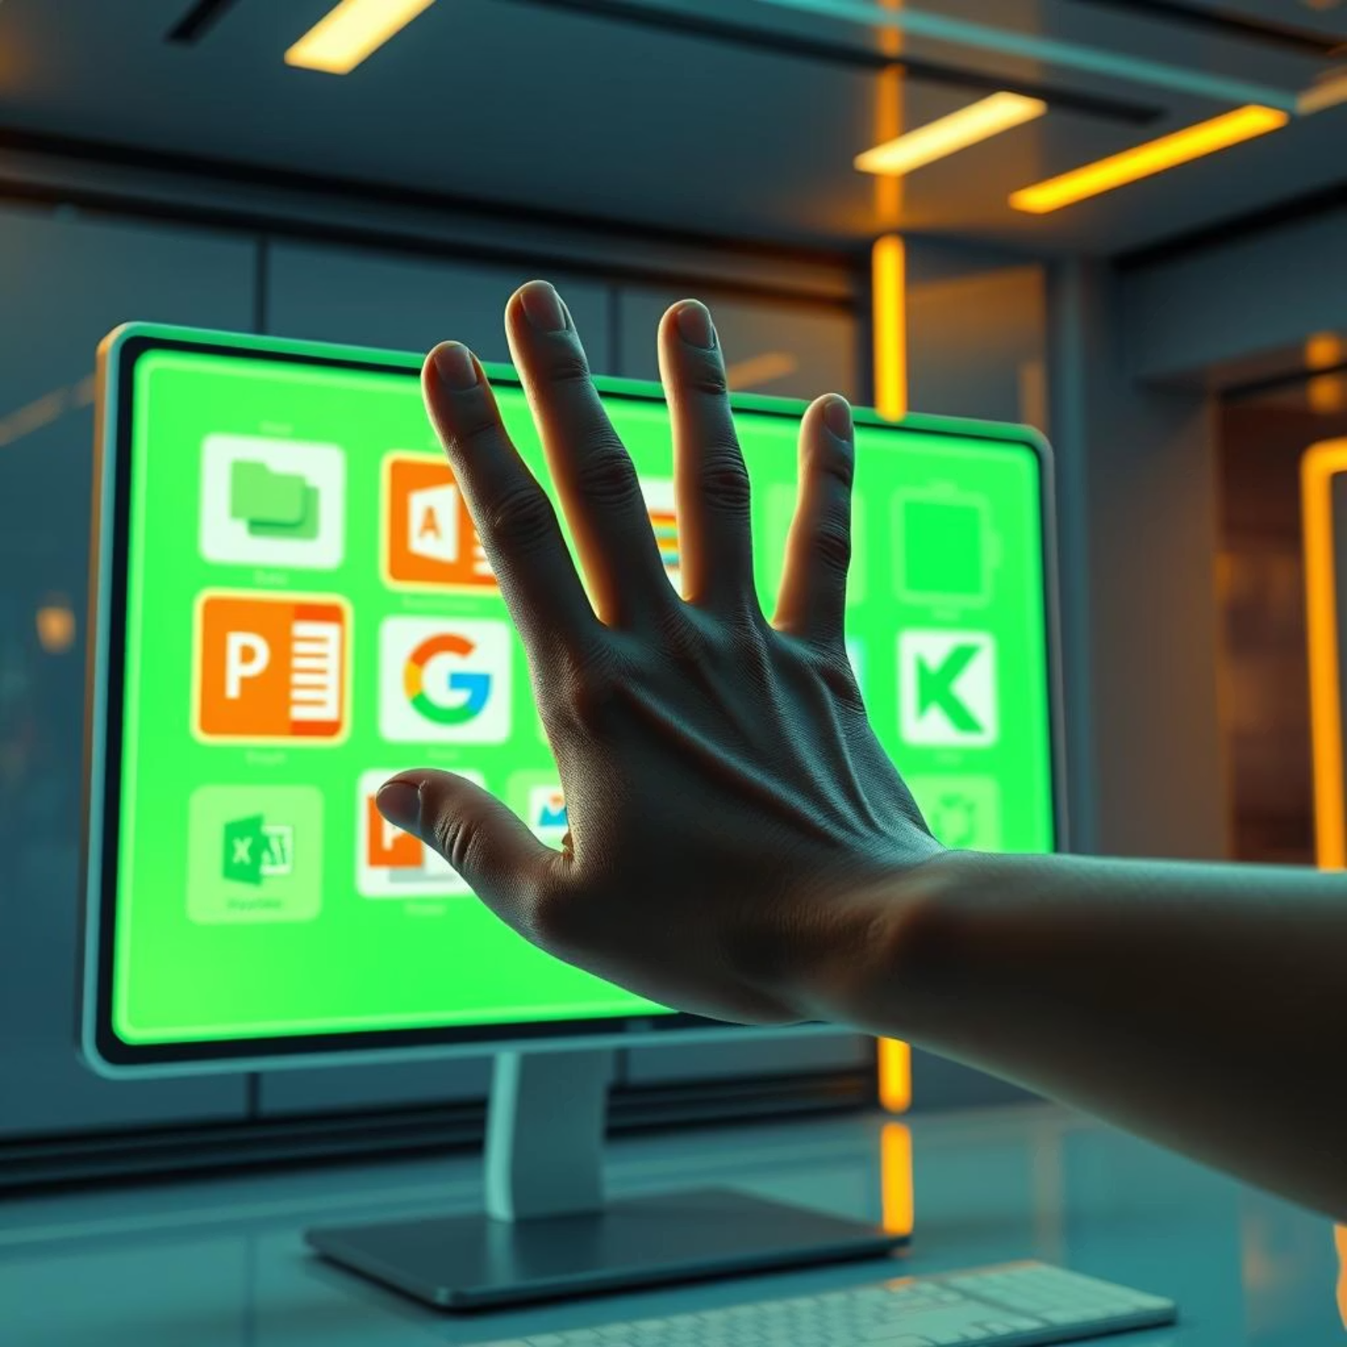
Key Advantages
Why GestureFlow Stands Out
Hardware Agnostic: No specialised hardware required. All you need is a standard webcam, making it universally accessible and cost-effective.
Universal Compatibility: Works seamlessly with any presentation software – PowerPoint, Google Slides, Keynote, and more – by simulating keyboard and mouse commands.
Empower your presentations with the freedom of gesture control.

